Slide 1
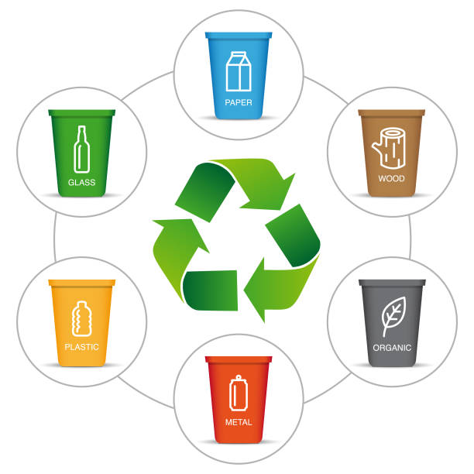
EcoVault:
EcoVault is a user-friendly mobile application designed to streamline waste management processes. The system operates on a three-tiered structure, comprising user, delivery, and factory modules.
by
Renuka Kamath
Krishna Anilkumar
Sidharth Suresh

Slide 2
Modules and Features
User Module
Delivery Module
Factory Module
Users can easily register and log in to the app to submit waste collection requests, specifying the type, quantity, and location of their waste.
The delivery module involves a network of registered delivery personnel who are assigned tasks based on their availability and proximity to the user's location.
The factory module manages the overall waste collection process, including task assignment, status updates, and payment distribution.

Slide 3
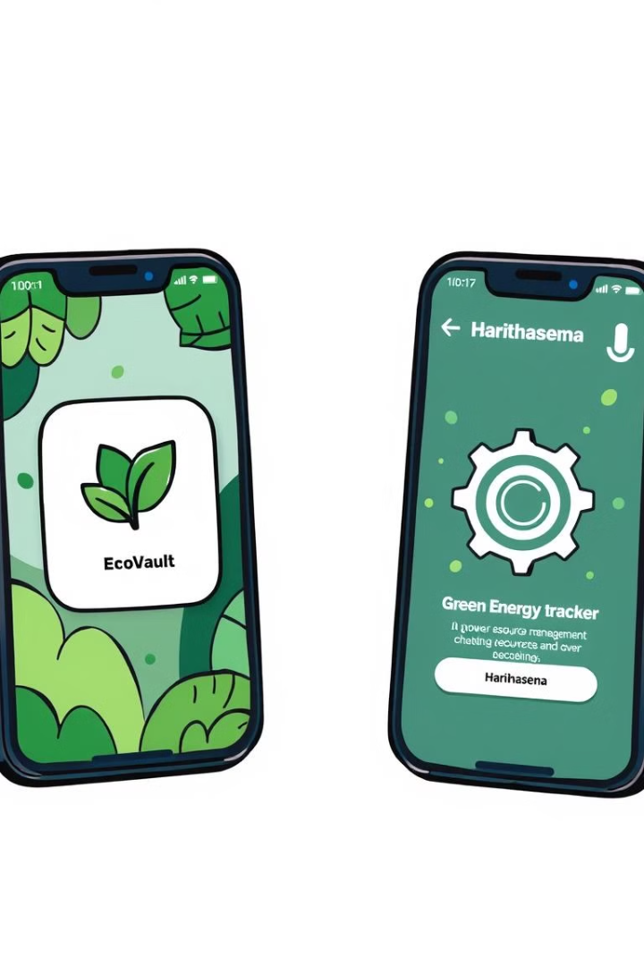
Existing System
EcoVault vs. Harithasena
Feature
EcoVault
Harithasena
Waste Types
Biogas, human waste, and plastic waste
Plastic waste only
System Functionality
User registration, online requests, task assignment, real-time tracking, and payment processing
Limited functionality
Efficiency
Optimized waste collection processes, potentially leading to reduced costs and increased efficiency
Traditional methods, potentially less efficient

Slide 4

Proposed System
1
Citizen Reporting
2
Verification Process
Users can capture and upload images of littering incidents.
A team of moderators or automated algorithms will review the submitted images to verify the validity of the report.
3
Rewards
4
Fines
Users who submit verified reports will receive rewards, such as points, discounts, or tangible prizes.
Individuals identified as responsible for littering will be issued fines, which can be paid through the app or website.

Slide 5

Benefits of the Proposed Enhancement
Increased Accountability
Community Engagement
Environmental Impact
Reducing littering will contribute to a cleaner and healthier environment.
The ability to report littering incidents will deter individuals from disposing of waste improperly.
By involving citizens in waste management, the system can foster a sense of responsibility and ownership.

Slide 6

Implementation Considerations
1
Reward Structure
The reward system should be designed to incentivize reporting while remaining cost-effective.
2
Fine Enforcement
A mechanism for collecting fines should be established, possibly through partnerships with local authorities.
3
Privacy and Data Security
Measures should be in place to protect the privacy of individuals involved in reporting and receiving fines.

Slide 7




Actors
User
Registers, submits requests, views status, schedules collections, reports littering, receives rewards.
Delivery Person
Registers, receives tasks, collects waste, updates status, receives payment.
Factory
Manages requests, assigns tasks, processes payments, updates status.

Slide 8
User Daily Life
User Registration
1
The user opens the EcoVault app and registers with their phone number and name.
2
Waste Collection Request
The user submits a request to the factory, specifying the type, quantity, and location of their waste.
Factory Confirmation
3
The factory receives the request and sends a confirmation response to the user.
4
Task Assignment
The factory assigns the task to an available delivery person based on their location.
Delivery Person Arrival
5
The delivery person arrives at the user's location and verifies their identity using an OTP.
6
Waste Collection
The delivery person collects the waste from the user.
Delivery Person Returns to Factory
7
The delivery person returns to the factory and completes the task.
8
Payment
The delivery person receives payment for completing the task.

Slide 9
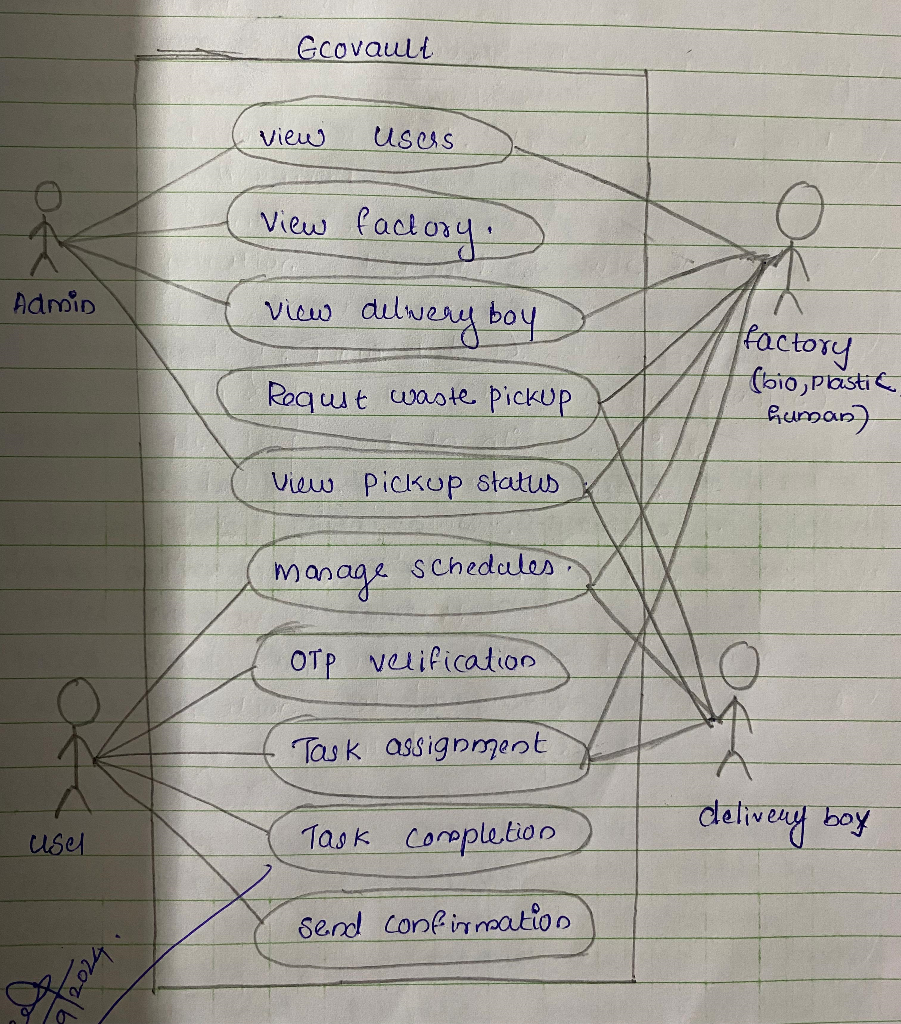
UseCase Diagram

Slide 10

THANK YOU
EcoVault:
EcoVault is a comprehensive waste management system that aims to improve waste collection processes and promote responsible waste disposal. The system offers a user-friendly interface, efficient task assignment, and real-time tracking, making it a valuable tool for individuals, businesses, and communities.

